Slide 1


Final Software Project

Slide 2

AGENDA
SRS Document
UML Design Model
Landing, Login and Enrollment Pages
SQL Databases
PHP Code

Slide 3

SRS Document
The SRS Document for our purposes was best utilized for showing the requirements for specific use cases
Objective –.
Priority –
Source –Actors –Flow of Events
Basic Flow
Alternative Flow 1 –Exception Flow 1 –
Includes
Preconditions –Post conditions –
Notes/Issues –

Slide 4
SRS Document
Register a User
Objective – User should be able to register with the website and unlock additional features.
Priority – High
Source – Carl Gnome (marketing)
Actors – Customer, central bank computer
Flow of Events
Basic Flow
Customer clicks ‘Register’
Prompted with required fields.
Registered with the website.
Alternative Flow 1 – If required information is not available.
An error message is shown to the user.
Exception Flow 1 – User attempts to register an already registered username.
An error message is shown to the user.
Includes
Preconditions – User has not logged in.
Post conditions – User is registered in the database.
Notes/Issues –
Each new user should have a unique ID associated with a password. The system should guard against two users using the same ID for registration.
Profiles must include some key information about the applicant including name, phone, email, and any other information you may see necessary.

Slide 5
SRS Document
Login a User
Objective – User should be able to login after being registered.
Priority – High
Source – Carl Gnome (marketing)
Actors – Customer, central bank computer
Flow of Events
Basic Flow
Customer clicks ‘Log In
Prompted with User ID and Password
Logged in to website.
Alternative Flow 1 – Wrong User ID and Password combination.
An error message is shown to the user.
Exception Flow
Includes
Preconditions –
User has not logged in.
User has already registered.
Post conditions – User is logged in.
Notes/Issues –
Post registration, users can login to the system at any time using the ID and the password created during the registration process.

Slide 6
SRS Document
Register for a Class
Objective – Users can register for classes.
Priority – High
Source – Carl Gnome (marketing)
Actors – Customer, central bank computer
Flow of Events
Basic Flow
User selects ‘Classes’.
User selected ‘Register’ on a class.
User added to the class roster.
Alternative Flow 1 – Class is full.
User is prompted to be added to the wait list.
User confirms, the user is added to the wait list.
Exception Flow
Includes
Preconditions –
User has not logged in.
User has already registered.
Post conditions – User is logged in.
Notes/Issues –
Each course should have a maximum number of enrollments that may be different depending on the course.
If a user wants to enroll into a course and the course is full, the student can add themselves onto a waiting list.

Slide 7
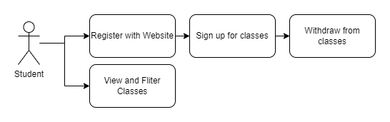
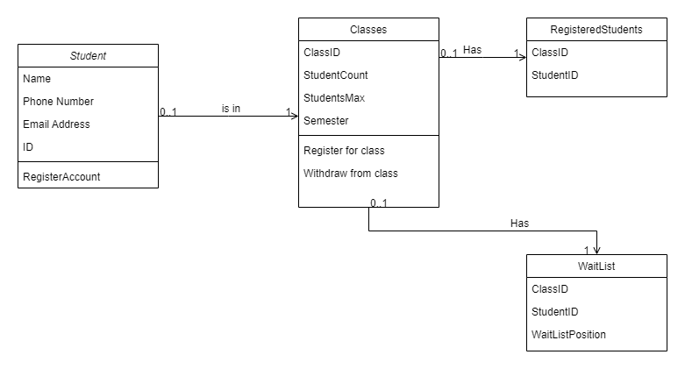
UML Model
The UML Models for Use Cases and the
Class Diagram help us organize the work
To be performed and guide our thoughts.
By using the SRS document we can
Create practical organization diagrams
Before we start work and save time.

Slide 8
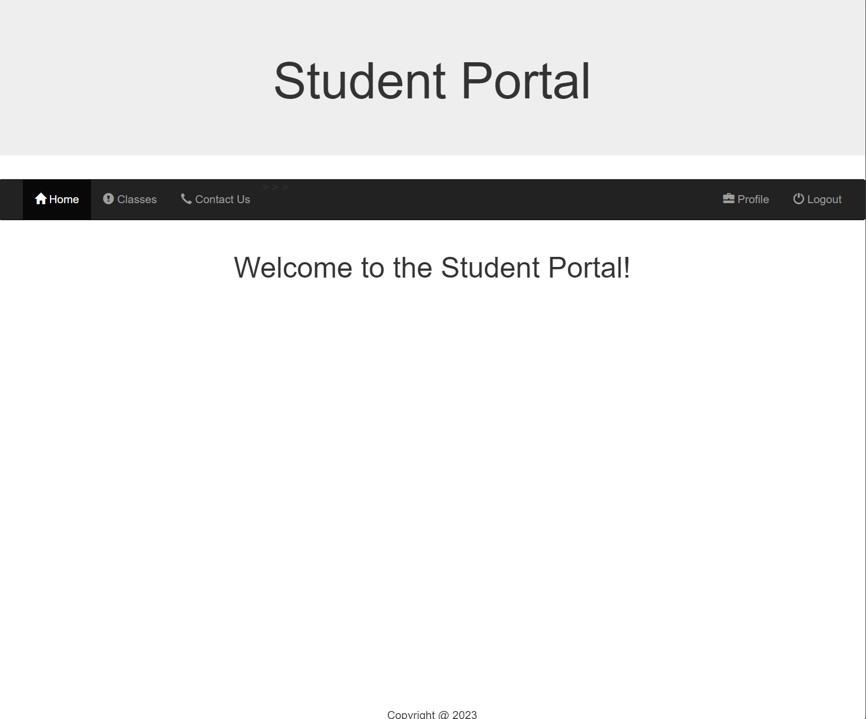
Landing Page
The landing page is simple, and has links to the various needed pages for work.

Slide 9
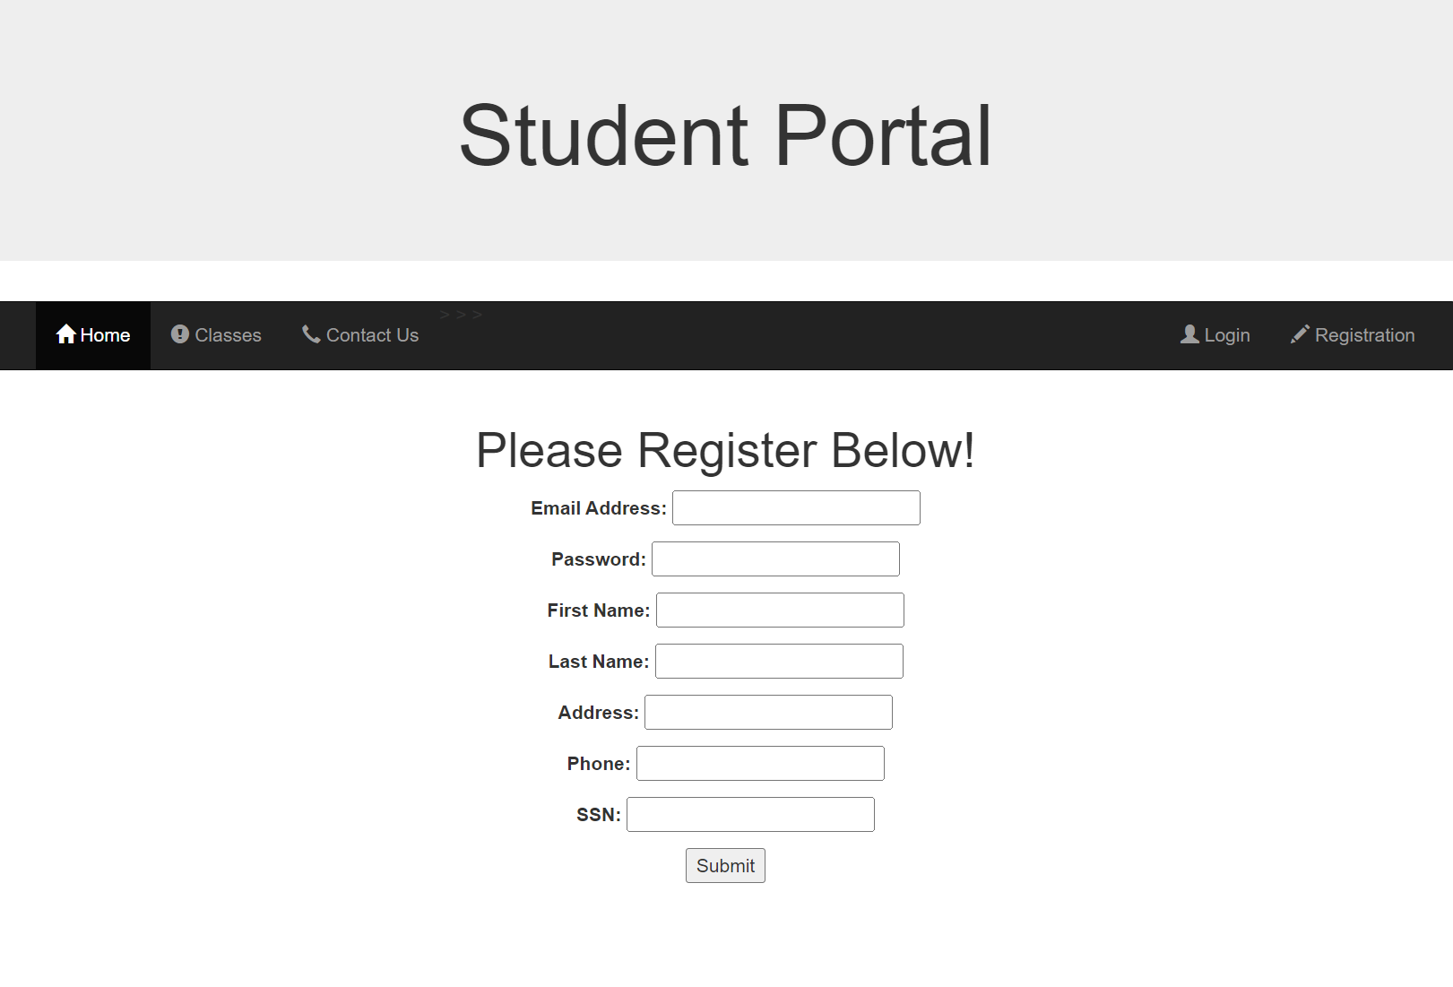
Registration Page
The registration page takes in relevant user information and creates a database entry for them.
Currently the only utilized fields are the Email, Password, and Firstname.

Slide 10
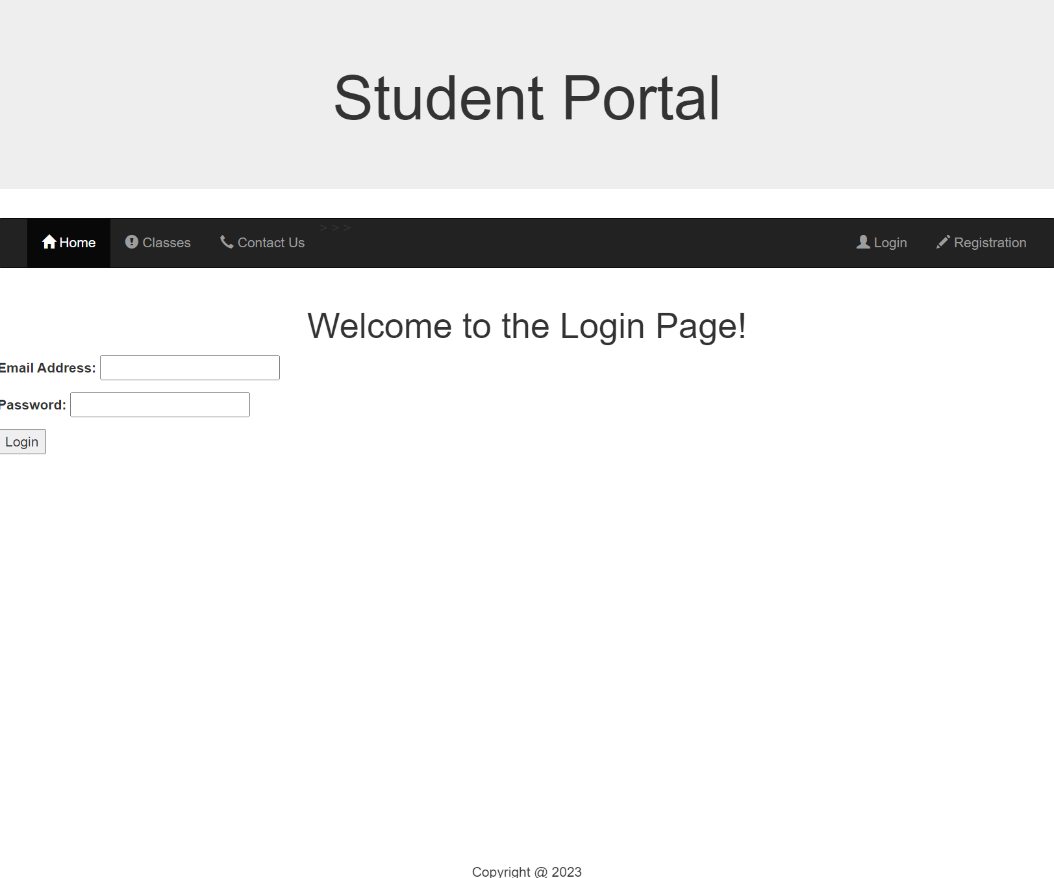
Login Page
The login page takes any valid combination of email and password and creates a session for use.

Slide 11
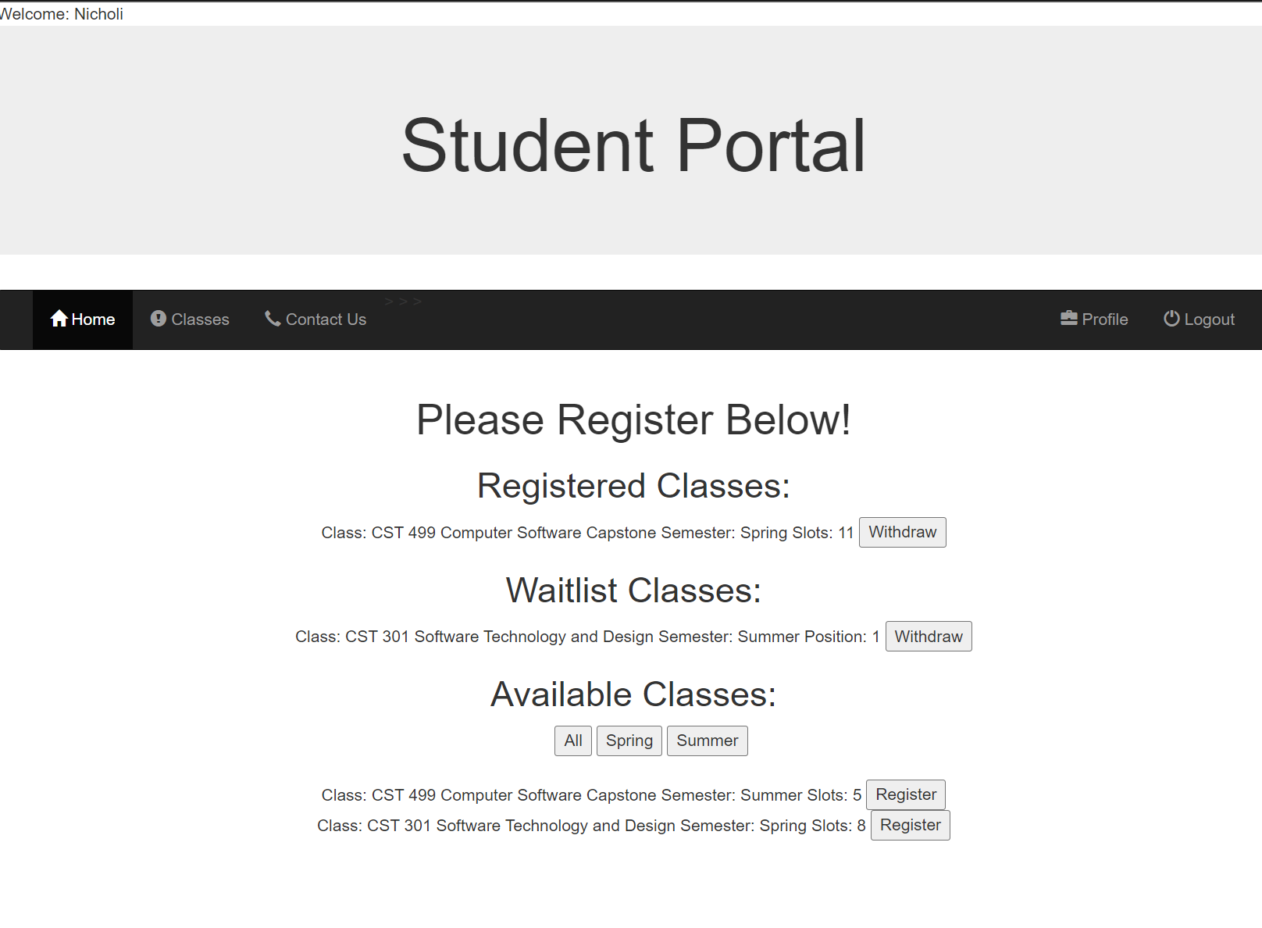
Class Registration Page
Student can view their registered class, the classes they are on the waitlist for, and the available class.
For available classes, the student can filter the list to those classes available in the spring or summer semester, or all.

Slide 12
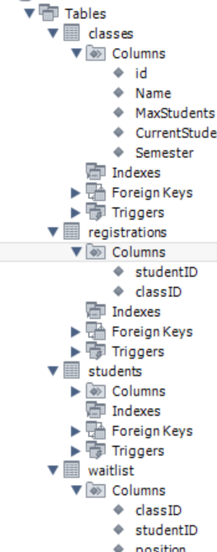
Databases
The database is 2 main tables
Classes – list of all classes
Students – list of all students
Along with 2 association tables.
Registrations – student to class
Waitlist – student to waitlist and class

Slide 13
Register for a Class PHP
function RegisterForAClass($classID, $studentID,$conn){
if (ClassAvailability($classID,$conn) > 0){
$sql = "INSERT INTO registrations VALUES ($studentID, $classID);";
$result = mysqli_query($conn, $sql) or die(mysqli_error());
UpdateAvailability($classID, 1,$conn);
header ("Location: classes.php?error=Registered.");
}else{
AddToWaitlist($classID, $studentID,$conn);
header ("Location: classes.php?error=Added to waitlist.");
}
}
When registering for a class, we check if the class has availability.
Available – add the user to the class and update the availability.
Unavailable – Add the user to the waitlist.
function UpdateAvailability($classID, $spot,$conn){
if ($spot > 0) {
$sql = "UPDATE classes Set CurrentStudents = CurrentStudents + $spot where id = $classID;";
$result = mysqli_query($conn, $sql) or die(mysqli_error());
}else{
$sql = "UPDATE classes Set CurrentStudents = CurrentStudents - abs($spot) where id = $classID;";
$result = mysqli_query($conn, $sql) or die(mysqli_error());
}
}
function AddToWaitlist($classID, $studentID,$conn){
$sql = "SELECT MAX(position)+1 as Position from waitlist WHERE classID = $classID";
$position = mysqli_query($conn, $sql);
$row = $position->fetch_assoc();
$position = $row['Position'];
if(is_null($position)){
$position = 1;
}
$sql = "INSERT INTO waitlist VALUES ($classID, $studentID, $position)";
$result = mysqli_query($conn, $sql);

Slide 14
Withdraw from a Class PHP
function WithdrawFromClass($classID, $studentID, $conn){
$sql = "DELETE FROM registrations where studentID = $studentID and classID = $classID";
$result = mysqli_query($conn, $sql) or die(mysqli_error());
UpadteAvailability($classID, -1,$conn);
AddFromWaitlist($classID, $studentID,$conn);
header ("Location: classes.php?error=$sql");
}
When withdrawing from a class, the user is removed from the class.
The availability is updated.
If there is a waitlist, a user is added from it.
function UpdateAvailability($classID, $spot,$conn){
if ($spot > 0) {
$sql = "UPDATE classes Set CurrentStudents = CurrentStudents + $spot where id = $classID;";
$result = mysqli_query($conn, $sql) or die(mysqli_error());
}else{
$sql = "UPDATE classes Set CurrentStudents = CurrentStudents - abs($spot) where id = $classID;";
$result = mysqli_query($conn, $sql) or die(mysqli_error());
}
}
function AddFromWaitlist($classID, $studentID, $conn){
$sql = "SELECT studentID
from waitlist
WHERE classID = $classID
order by position desc
limit 1";
$result = mysqli_query($conn, $sql) or die(mysqli_error());
$row = $result->fetch_assoc();
$result = $row['studentID'];
if (is_null($result)){
exit();
}else{
RegisterForAClass($classID, $result, $conn);
WithdrawFromWaitlist($classID, $result, $conn);
}

Slide 15
Withdraw from waitlist
function WithdrawFromWaitlist($classID,$studentID,$conn){
$currentPosition = CheckWaitlistPosition($classID, $studentID, $conn);
$sql = "DELETE FROM waitlist WHERE classID = $classID
AND studentID = $studentID";
$result = mysqli_query($conn, $sql) or die(mysqli_error());
UpdateWaitlist($classID,$currentPosition,$conn);
header ("Location: classes.php?error=Removed from waitlist.");
}
When withdrawing from a waitlist, the position of the user is gathered, then they are removed from the waitlist.
Anyone after that user on the list has their position updated.
function CheckWaitlistPosition($classID,$studentID,$conn){
$sql = "SELECT position FROM waitlist WHERE classID = $classID AND studentID = $studentID";
$result = mysqli_query($conn, $sql) or die(mysqli_error());
$row = $result->fetch_assoc();
$result = $row['position'];
return $result;
}
function UpdateAvailability($classID, $spot,$conn){
if ($spot > 0) {
$sql = "UPDATE classes Set CurrentStudents = CurrentStudents + $spot where id = $classID;";
$result = mysqli_query($conn, $sql) or die(mysqli_error());
}else{
$sql = "UPDATE classes Set CurrentStudents = CurrentStudents - abs($spot) where id = $classID;";
$result = mysqli_query($conn, $sql) or die(mysqli_error());
}
}

Slide 16
EFFECTIVE DELIVERY TECHNIQUES
Effective body language enhances your message, making it more impactful and memorable.
Meaningful eye contact
Purposeful gestures
Maintain good posture
Control your expressions
This is a powerful tool in public speaking. It involves varying pitch, tone, and volume to convey emotion, emphasize points, and maintain interest.
Pitch variation
Tone inflection
Volume control

Slide 17
NAVIGATING Q&A SESSIONS
Know your material in advance
Anticipate common questions
Rehearse your responses
Maintaining composure during the Q&A session is essential for projecting confidence and authority. Consider the following tips for staying composed:
Stay calm
Actively listen
Pause and reflect
Maintain eye contact

Slide 18

THANK YOU
Nicholi D’Amato

